Slide 1
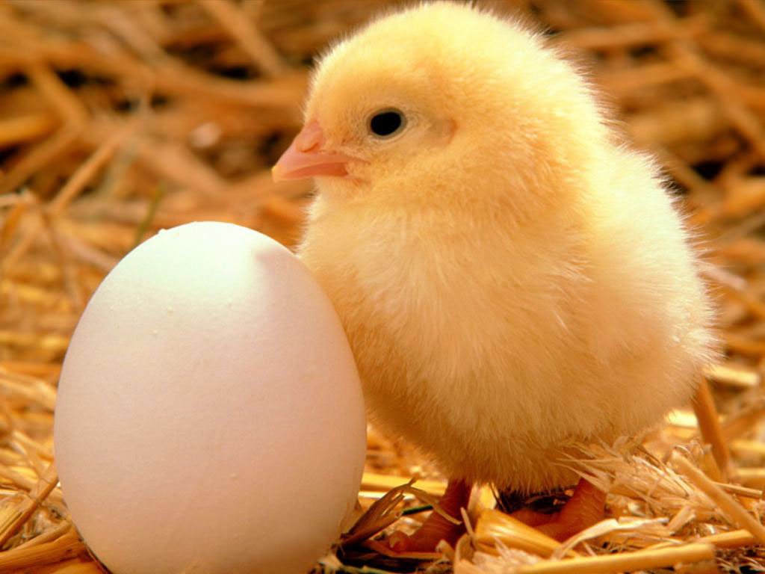
Baby Animals
Maral.h70@gmail.com

Slide 2
This dog has four puppies.
They are very cute.

Slide 3
This is a kitten.
A kitten is a baby cat.

Slide 4
This is a mother sheep.
She has a lamb.

Slide 5
These are baby rabbits.
They have long ears.

Slide 6
This lion has two cubs.
Lion cubs like to play.

Slide 7
This baby gorilla is on his father’s back.
He loves his father.

Slide 8
These baby birds are on the tree.
Tree

Slide 9
Thank You!

