Slide 1
Take Care!
By Yasaman SamsamiRad

Slide 2
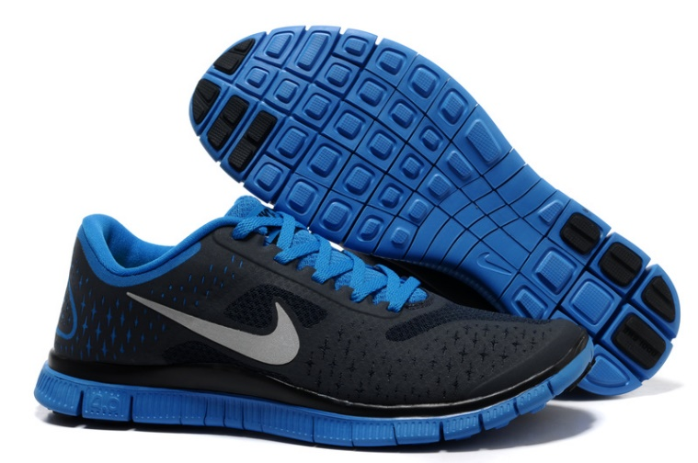
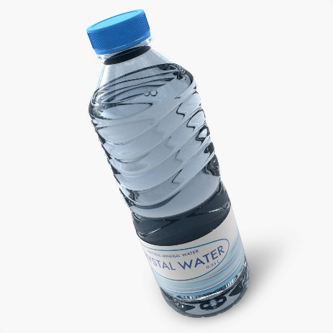
Walking quickly is good for your heart. Take a bottle of water and remember to wear comfortable shoes.

Slide 3
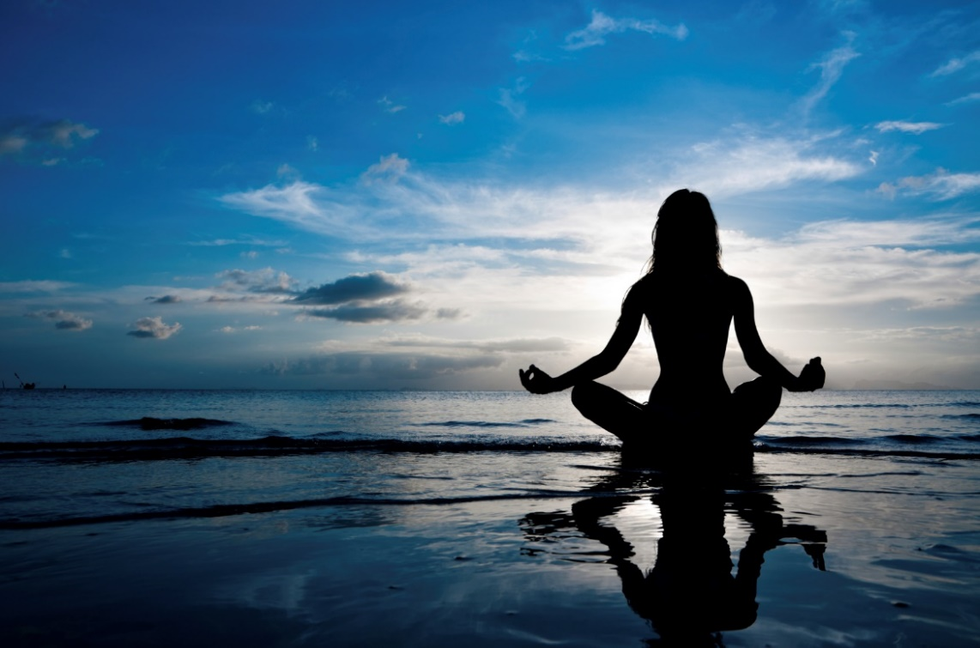
Practice yoga to learn breathing exercises and body postures. It is good for your body and mind.

Slide 4
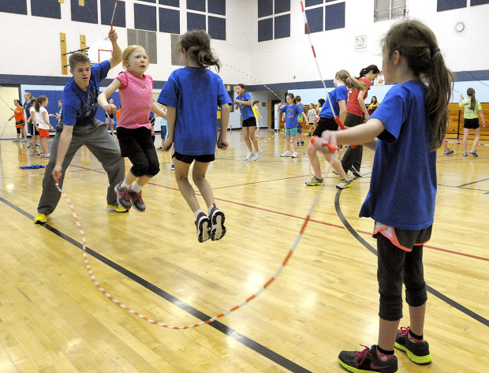
Jump rope is great. You can jump rope by yourself or with friends. It is good for your heart and muscles.

Slide 5
You should warm up and stretch before you practice a sport.

Slide 6
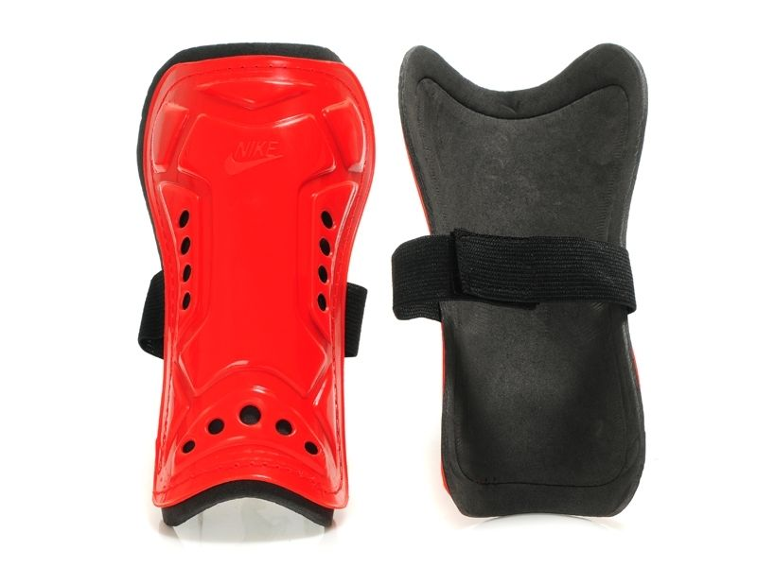
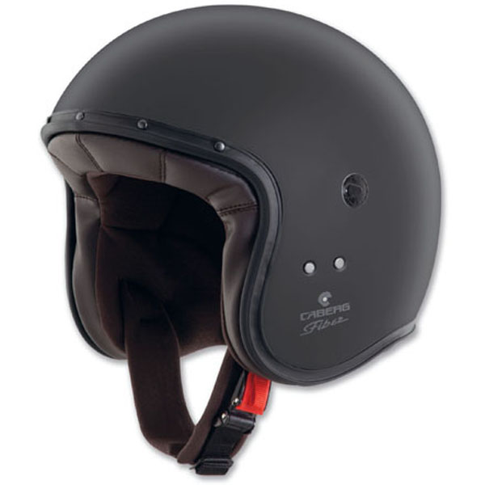
You should wear equipment to protect yourself. If you don’t, you could get hurt.

Slide 7
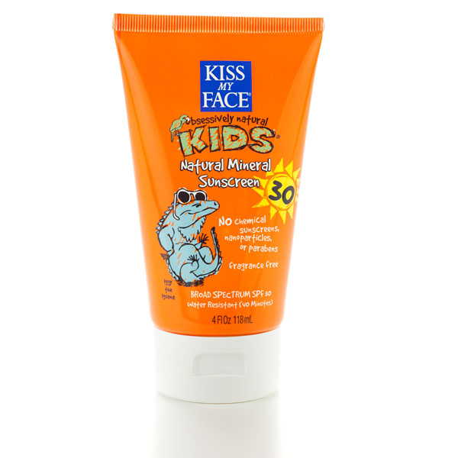
Swimming in a pool or in the ocean is a lot of fun. Always swim with another person. Don’t forget to use your sunscreen on sunny days to protect yourself.

Slide 8
Take care of yourself.

