Slide 1
Unit 4/ Take Care
By Yasaman Samsami

Slide 2
Do you use a helmet?
When?

Slide 3
Do you use sunglasses?
When?

Slide 4
When do we use tissues?

Slide 5
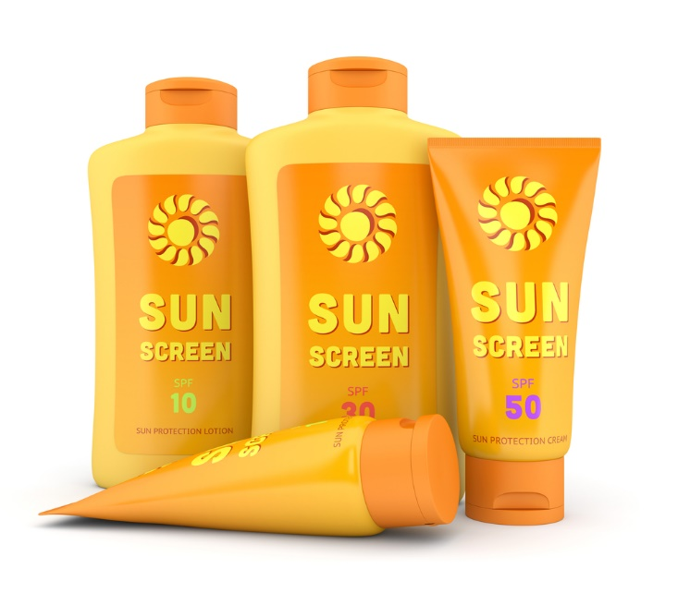
When do we use sunscreen?
Why?

Slide 6
What do you do when you have a problem?

Slide 7
I have a toothache.
You should go to the dentist.

Slide 8
I have a headache.
You should take some aspirin.

Slide 9
I have an earache.
You should go to the doctor.

Slide 10
I have a bad cold.
You should drink lots of water and rest in your bed.

Slide 11
I have a stomachache.
You should drink some tea.

Slide 12
What should we do if we have a bad cold?

Slide 13
What should we do if we have a headache?

Slide 14
Take care & good luck!

