Slide 1
Seasons, Weather
By: S. Pourlahiji ☺

Slide 2
Which season is it?

Slide 4
Spring

Slide 5
How’s the weather?

Slide 6
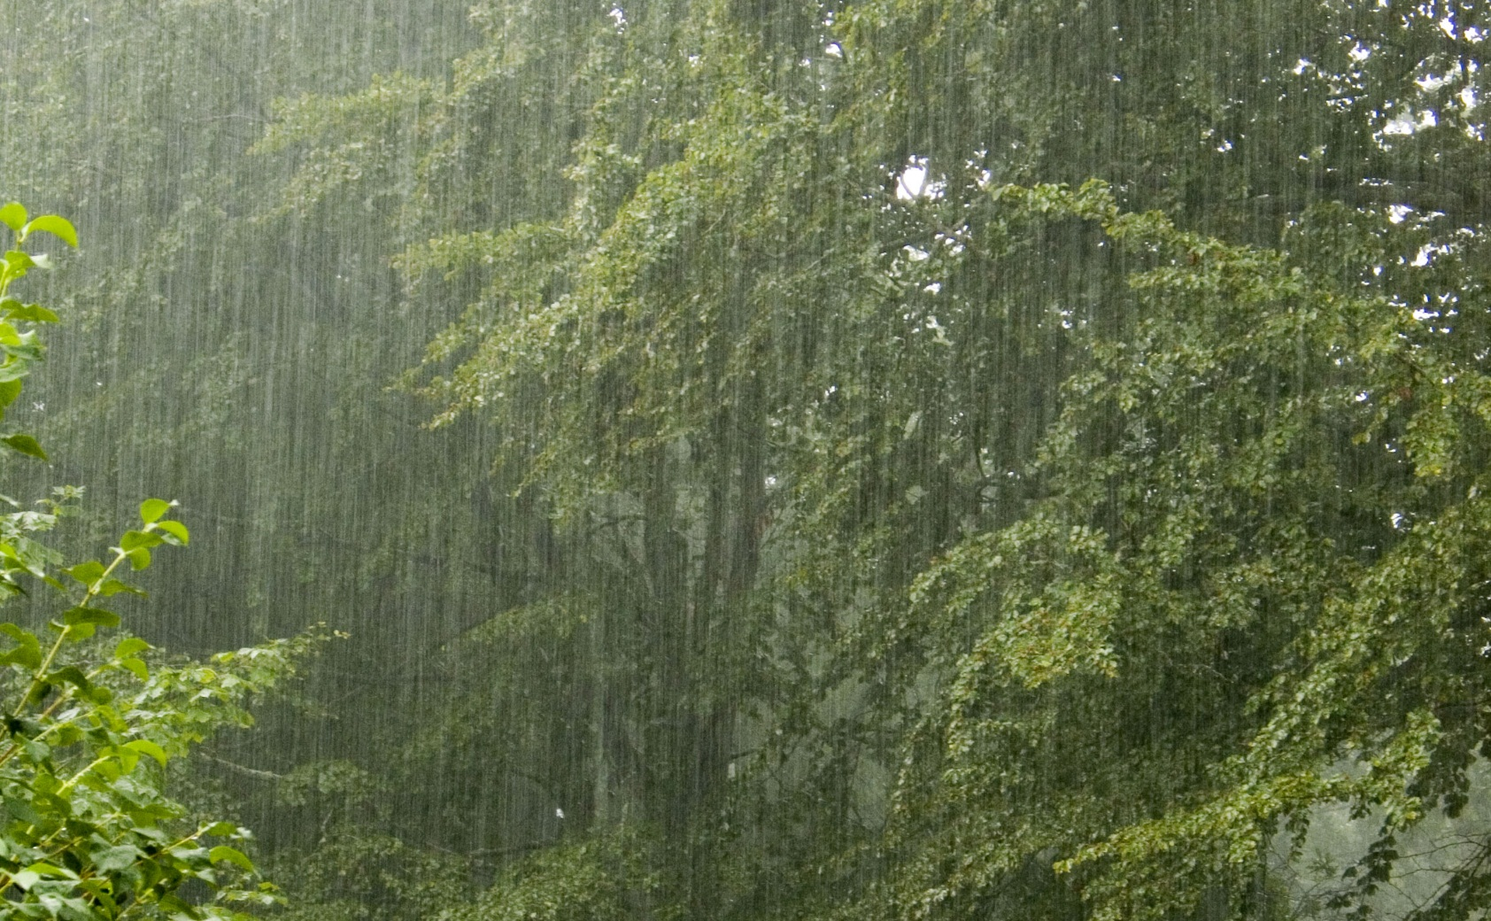
It’s Rainy.

Slide 7
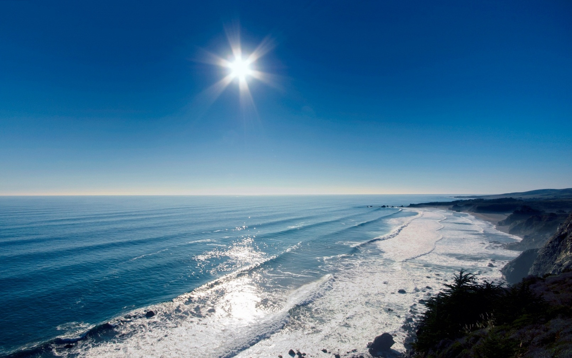
It’s Sunny and warm

Slide 8
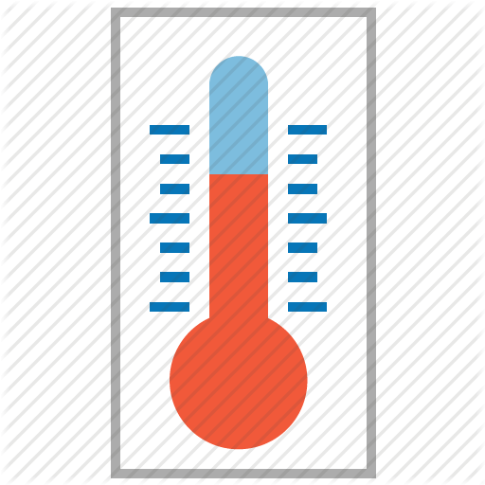
The temperature is rising in spring
Thermometer

Slide 9
Which season is it?

Slide 11
Summer

Slide 12
How’s the weather?

Slide 13
It’s Sunny and hot

Slide 14
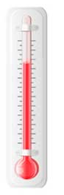

Slide 15
Which season is it?

Slide 17
Autumn

Slide 18
How’s the weather?

Slide 19
It’s Rainy and cold.

Slide 20
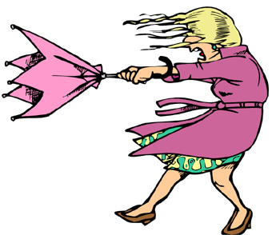
It’s windy.

Slide 21
The temperature is lowering in autumn.

Slide 22
Which season is it?

Slide 24
Winter

Slide 25
How’s the weather?

Slide 26
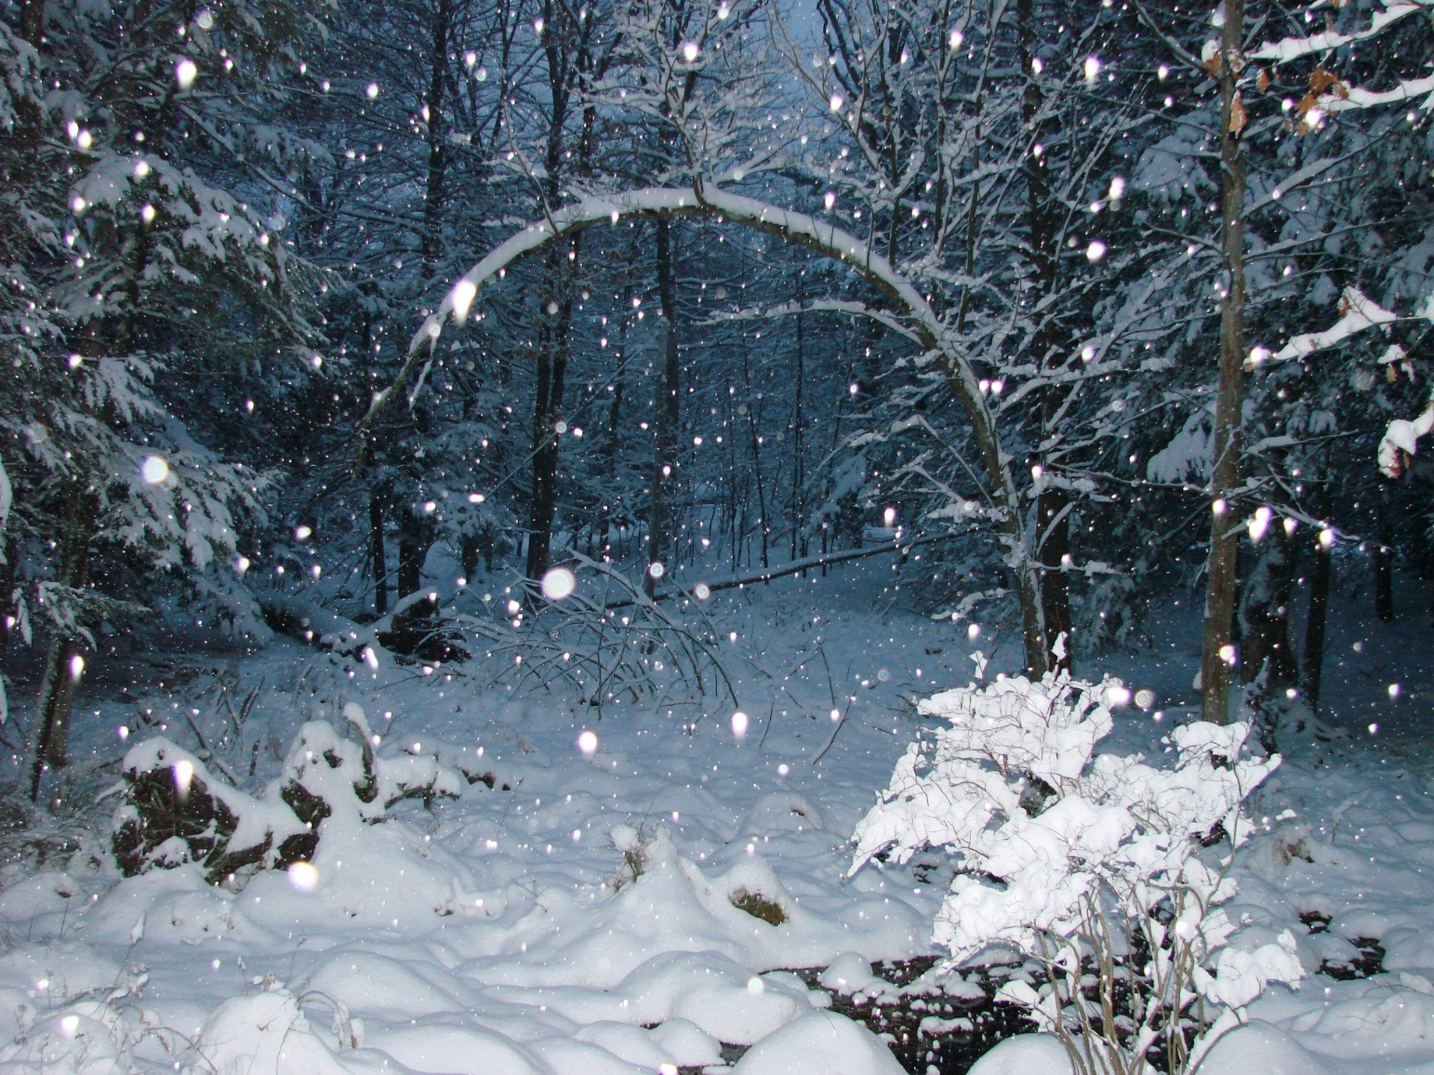
It’s Snowy and very very cold.

Slide 27
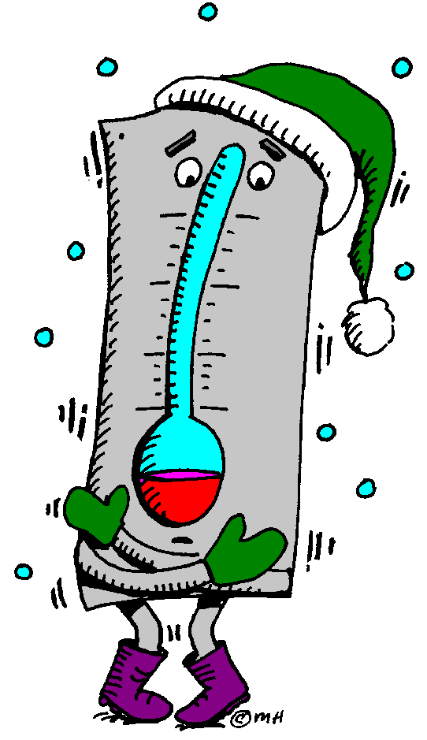

Slide 28
Thank you ☺
Sami_lahiji@yahoo.com

