Slide 1
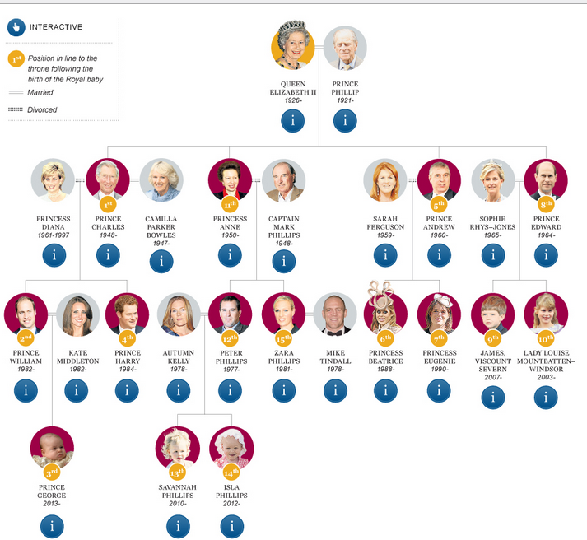
The Royal
Family
Tree
Name the family relationships
in the
Royal Family.

Slide 2
Royal Family Tree
Read HELP first and complete the exercise
Prince Philip and Queen Elizabeth are married they are
h______________ and w________________.
2. Prince Philip and Queen Elizabeth have four ____________________. One ___________________ and three ____________.
3. Queen Elizabeth is Prince Charles’ _______________________.
4. Prince Philip is Princess Anne’s _________________________.
5. Prince Charles and Price Edward are _____________________.
6. Prince Andrew and Princess Anne are ___________________
and _________________, they are ______________________.
7. Queen Elizabeth is Prince William and Prince Harry‘s ____________________.
8. Prince Philip is Princess Beatrice and Princess Eugenie ______________________.
9. Prince George, Sawannah Phillips and Isla Phillips are Queen Elizabeth and Prince Phillip’s ____________________________.
10. Prince Edward is Prince Harry’s ____________________.
11. Prince William, Princess Eugenie and Lady Louise are ____________________.
12. James and Lady Louise are _________________________.
HELP!
mother + father = parents
daughter + son = children
Brother + sister = siblings
grandmother + grandfather = grandparents
great-grandmother + great-grandfather = great - grandparents
granddaughter + grandson = grandchildren
great-granddaughter + great-grandson = great-grandchildren
My father’s brother is my uncle.
My uncle’s son is my cousin.

