Slide 1
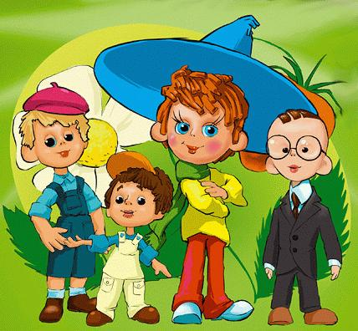
Mites from Sun City

Slide 2
Dialogue

Slide 3
Lets read
merry funny kind evil lazy | smart silly brave cute friendly | good bad nice joyful talented

Slide 4
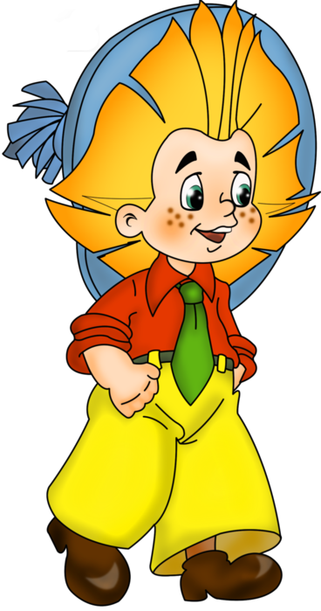
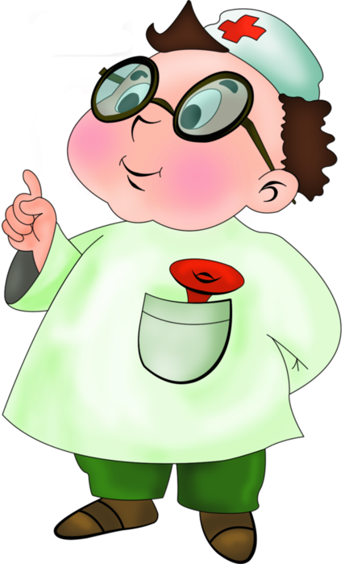
Mites
He is Neznaika.
He is Znaika.
He is Pilyulkin.

Slide 5
Lets read
swim cook watch TV skate ski | sing dance paint play football climb | read help knit write walk

Slide 6
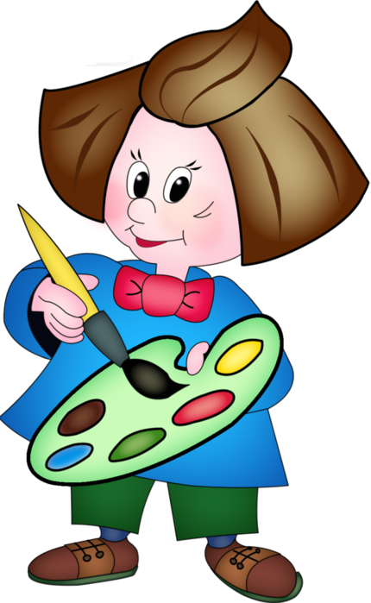
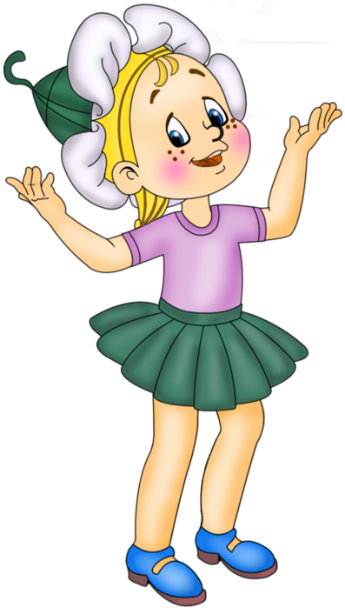
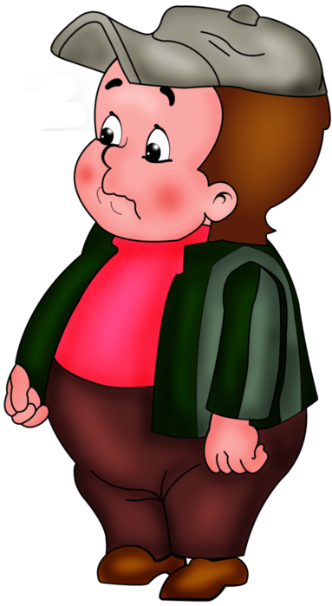
He is Tyubik.
She is Medunitsa.
He is Ponchik.

Slide 7
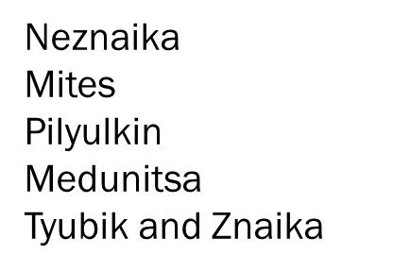
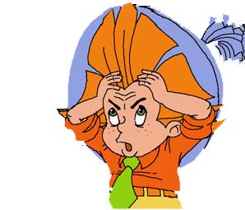
Choose the correct word
Neznaika
Mites
Pilyulkin
Medunitsa
Tyubik and Znaika
is
are
to be (am / is / are)
likes
like
like/likes

Slide 8
to be
Neznaika … a mite.
Znaika … a mite.
Pilyulkin … a mite.
Medunitsa and Tyubik … mites.
All mites ... friendly.
is
is
are

Slide 9
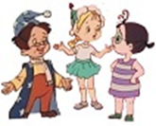
likes cooking and eating.
like talking.
likes helping.

Slide 10
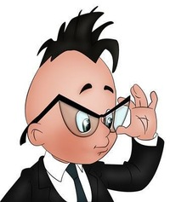
likes playing tricks.
likes reading.
and
like painting.

Slide 11
4.
Оформить работу
2.
Подобрать слова
3.
Написать текст
1.
Продумать содержание

Slide 12
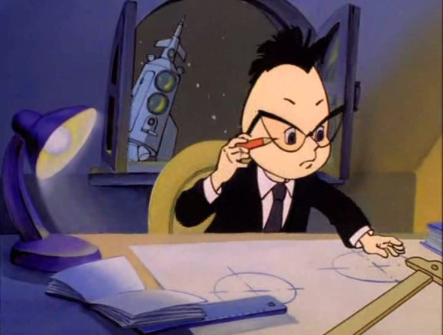
Hello!
This is Znaika. He is a mite. He is from Sun City. He is smart and cute, kind and brave. He likes reading and helping mites. I like Znaika very much.
Goodbye! All the best!
(Автор письма)

Slide 13
Список:
http://webcommunity.ru/24294/
http://www.gograph.com/stock-illustration/hello.html
http://fotki.yandex.ru/users/marya-foygl/album/167282/
http://www.statusyblog.ru/blog/smailiki_dlya_statusa_v_kontakte/2011-09-20-609
http://www.liveinternet.ru/users/3094518/post335093749/
http://demiart.ru/forum/index.php?showtopic=121959
http://www.liveinternet.ru/users/3731870/post148509994/
http://egoel.livejournal.com/40648.html
http://www.liveinternet.ru/users/3847529/post154657682/
http://aslan.livejournal.com/182042.html
http://loopy.ru/?word=%D0%B7%D0%BD%D0%B0%D0%B9%D0%BA%D0%B0

